Slide 1
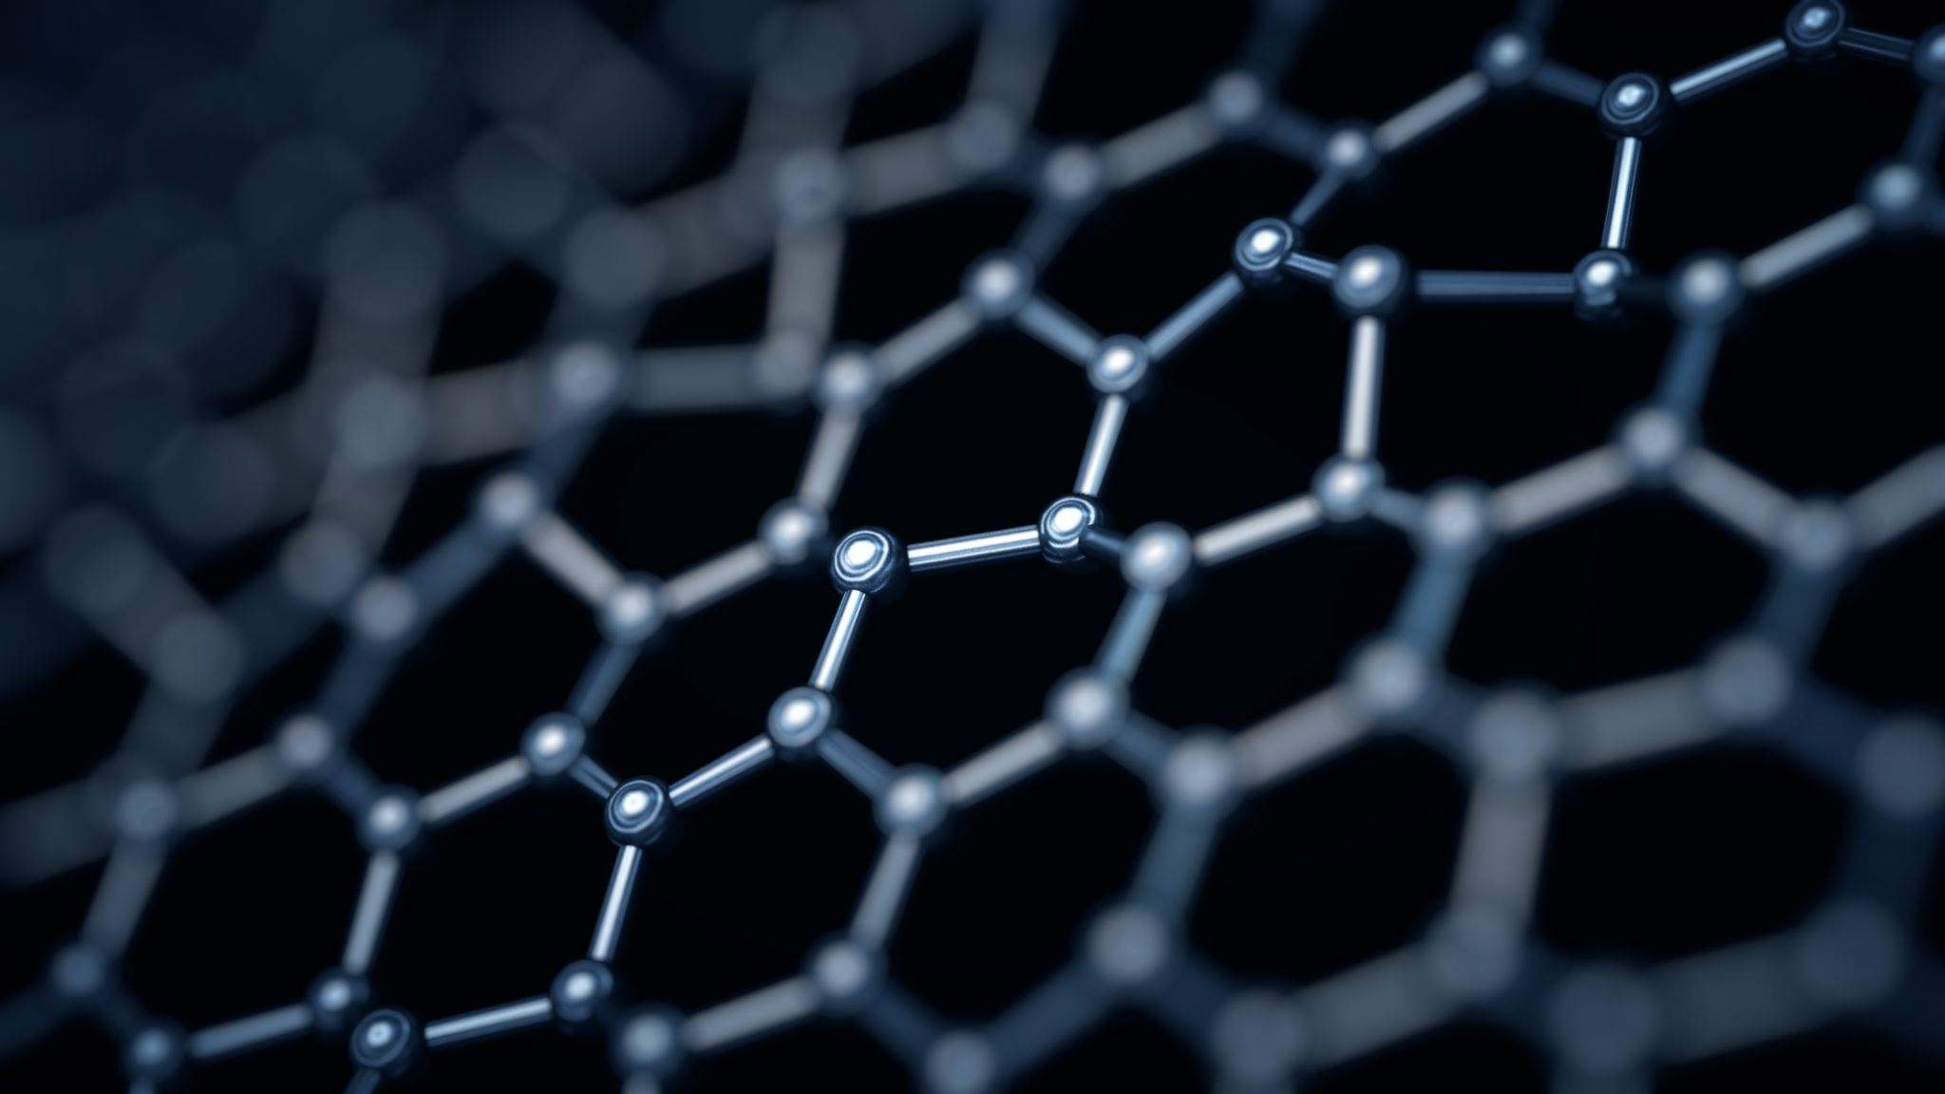




Optical thermodynamics
André L. Marques Muniz, Ph.D.
Friedrich-Hund-Dissertationspreis

Slide 2
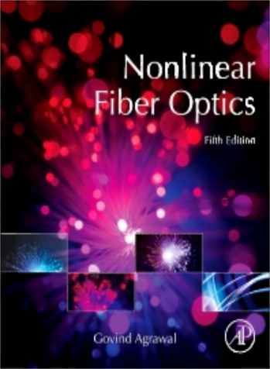
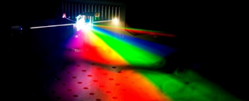


Single mode systems
Single mode systems
have so far dominated nonlinear fiber optics
Soliton generation
Supercontinuum generation
Fiber-based parametric oscillators
Pulse compression

Slide 3
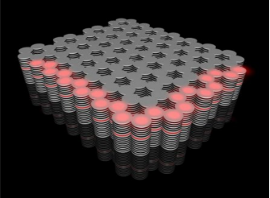
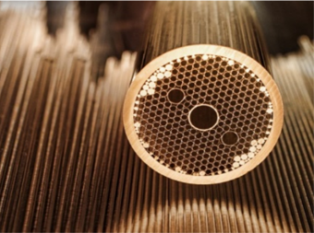

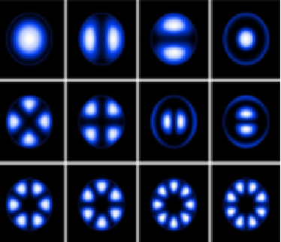
The comeback of multimode optical fibers
Progress
Space Division Multiplexing in MMF Systems
Precisely engineered GI-MMFs can now be realized
Why are they important?
Provide a rich platform to study fundamentally new, exciting nonlinear phenomena
Large core areas can lead to high power handling capabilities
Nonlinear optical dynamics in MMFs remain largely unexplored
They can potentially lead to high-brightness tunable sources

Slide 4

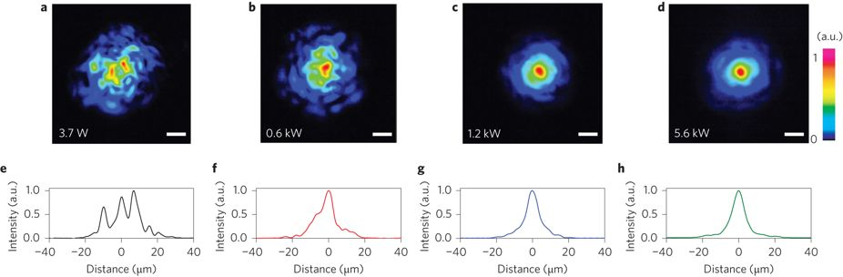
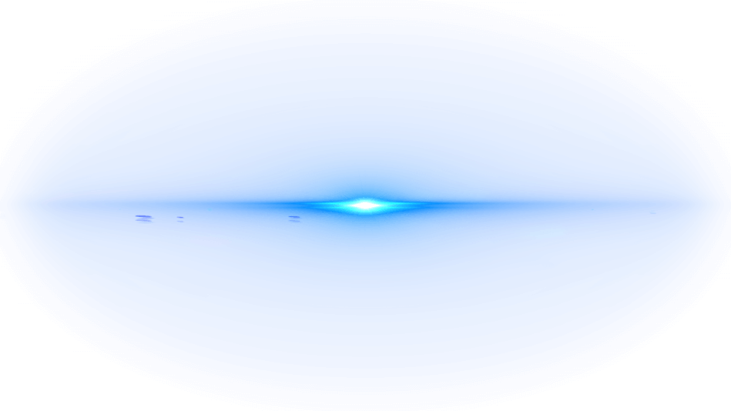
Beam “self-cleaning effect”
Flow of power from higher
to lower-order modes
Why?
Input
Output
Power per mode
8
7
6
5
4
3
2
1
G. Lopez-Galmiche et al, Opt. Lett. 41, 2553-2556 (2016)
Zhanwei Liu et al, Opt. Lett. 41, 3675-3678 (2016)
K Krupa et al - Nature Photonics, (2017)
Mode number

Slide 5


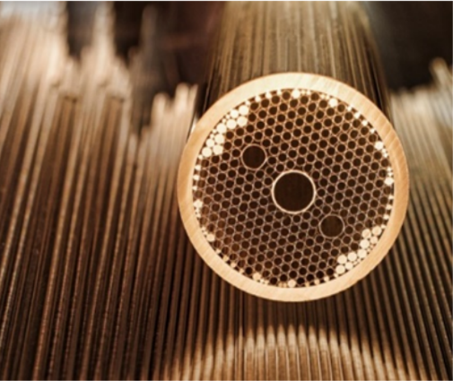
Highly multimoded systems
There is need for a new optical thermodynamic theory
capable of predicting the outcome of nonlinear dynamics in complex, heavily multi-moded systems.
multimode and coupled cavity arrangements
multimode and multicore fibers

Slide 6

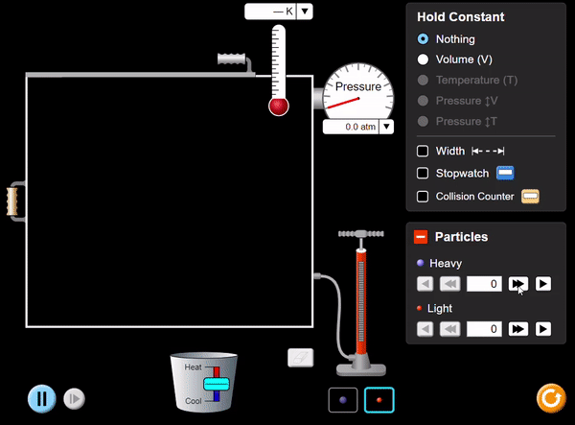
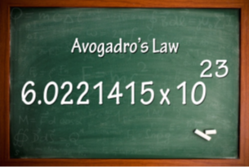


Many body interactions
As in actual systems, it is virtually impossible to follow the dynamics of $\sim 10^{23}$ colliding molecules on a one-by-one basis.
Thermodynamics
$$U=\frac{3}{2}Nk_{B}T$$
$$PV=Nk_{B}T$$
Internal energy
Ideal gas law

Slide 7
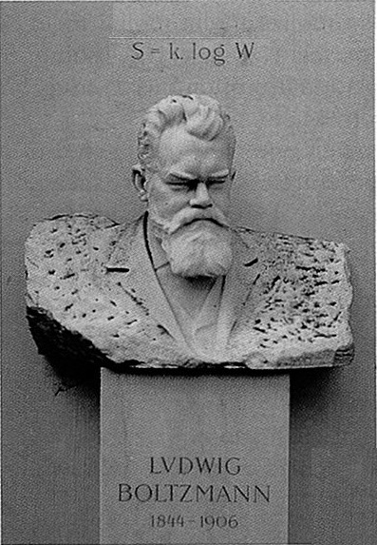

Optical thermodynamics
Classical thermodynamics: Maximizing entropy for predicting a statistical thermodynamic values.
Standard thermodynamics
at the microcanonical level
S = S(U, V,N)
U - Energy
Maximize Entropy S
V - Volume
N - particle number
to predict temperature, pressure and chemical potential

Slide 8

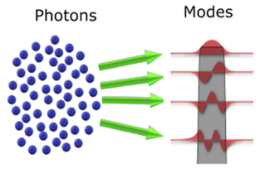
Optical thermodynamics
Maximizing photonic entropy as a basis for developing a statistical thermodynamic theory for light.
Formulation of optical thermodynamics
at the microcanonical level
S = S(U, M, P)
U - Energy
U – photonic internal energy
V - Volume
M – number of modes
N - particle number
N – optical power
(photon number)
Maximize Entropy S
to predict the temperature, pressure and chemical potential
Maximize photonic Entropy S
to predict the final power distribution among modes

Slide 9
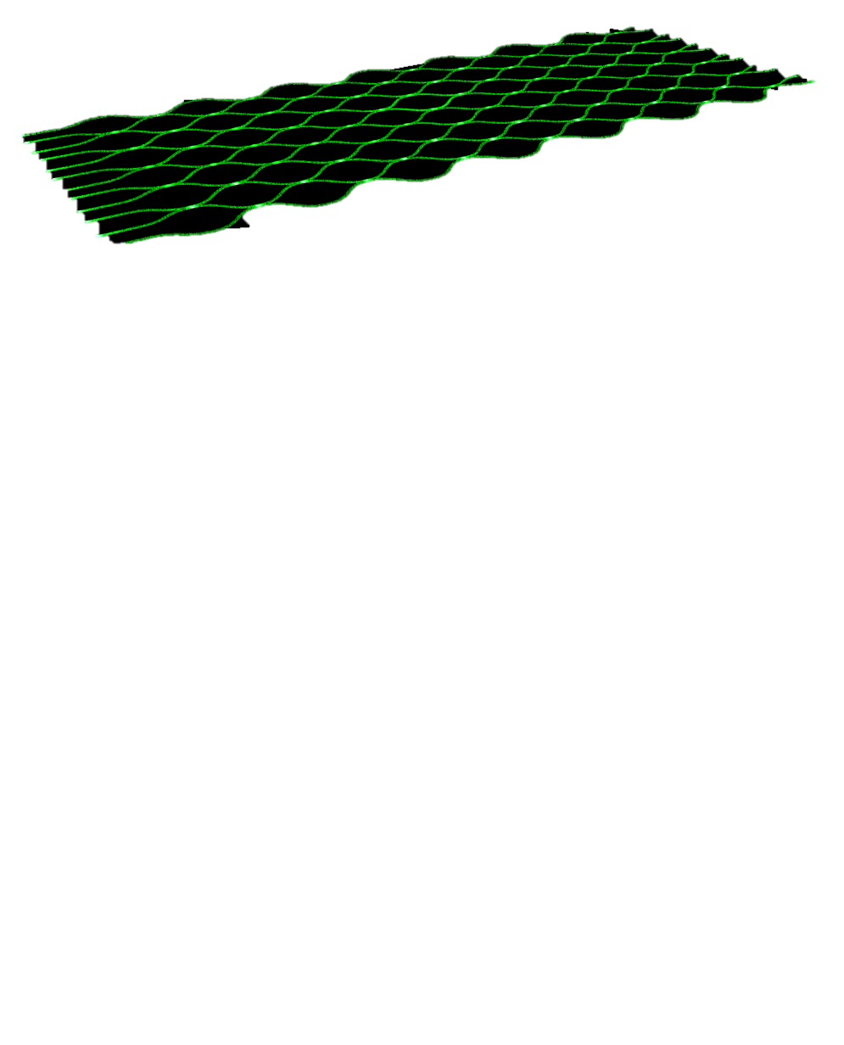
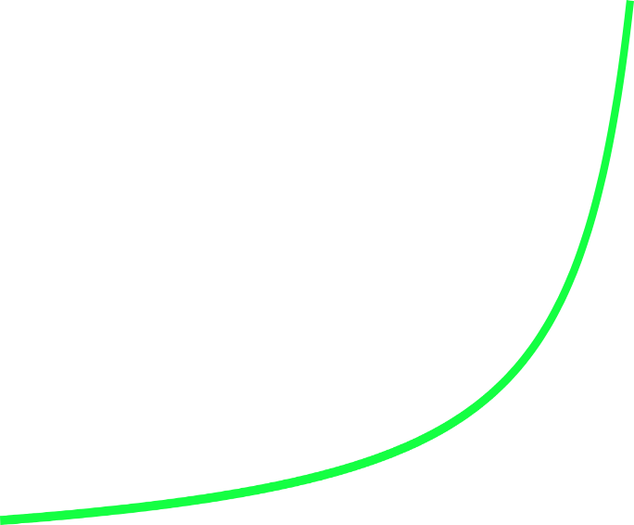




Thermal equilibrium
OUTPUT
INPUT
Random
modal occupancy
propagation
Entropy is maximized
$${|c_{i}|}^{2}$$
$${|c_{i}|}^{2}$$
-1.5
1
0.5
0
0.5
1
1.5
-1.5
1
0.5
0
0.5
1
1.5
$$ε_{i}$$
$$ε_{i}$$

Slide 10




The Rayleigh-Jeans distribution
OUTPUT
The mode occupancies in weakly nonlinear multimode systems attain a Rayleigh-Jeans distribution at thermal equilibrium
INPUT
propagation
optical temperature
modal occupancies
$${|c_{i}|}^{2}=−\frac{T}{ε_{i}+μ}$$
Entropy is maximized
$$S=\sum_{i}{{\ln\left|c_{i}\right|}^{2}}$$
$${|c_{i}|}^{2}$$
chemical potential
propagation constants
-1.5
1
0.5
0
0.5
1
1.5
$$ε_{i}$$
F. Wu et al, Nature Photonics 13 (11), 776-782 (2019)
M. Parto et.a, Optics letters 44 (16), 3936-3939 (2019)
K. Makris et al, Optics Letters 45 (7), 1651-1654(2020)

Slide 11





Thermal equilibrium
Entropy is maximized
OUTPUT
$$S=\sum_{i}{{\ln\left|c_{i}\right|}^{2}}$$
INPUT
propagation
The mode occupancies in weakly nonlinear multimode systems attain a Rayleigh-Jeans distribution
$${|c_{i}|}^{2}=−\frac{T}{ε_{i}+μ}$$
Entropy is maximized
$${|c_{i}|}^{2}$$
The temperature T and chemical potential μ depend on the extensive variables U,P and M via the Equation of State:
$$U−μP=MT$$
-1.5
1
0.5
0
0.5
1
1.5
$$ε_{i}$$

Slide 12
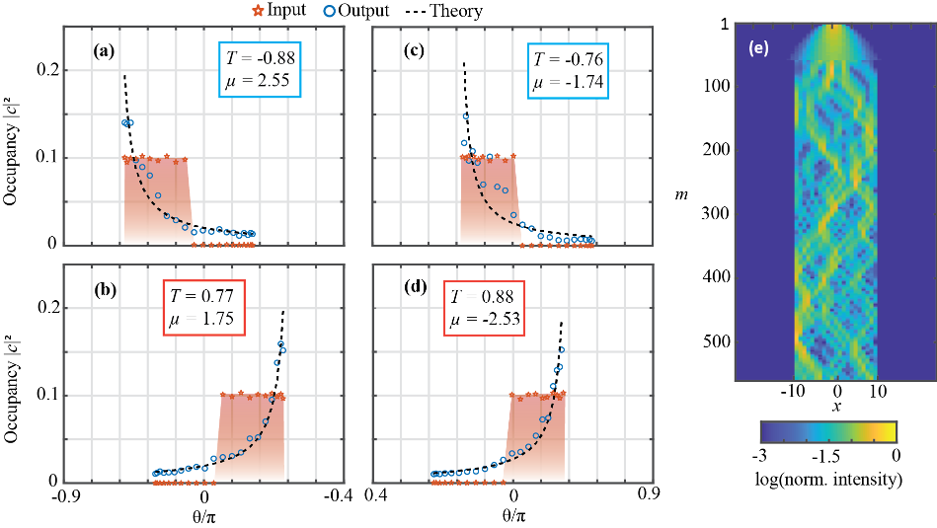

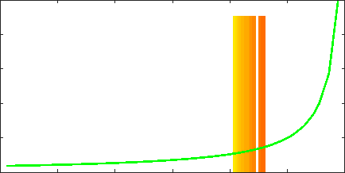










Measuring optical thermalization
1
experiment
Well fitted by a Rayleigh-Jeans distribution
100
0
$$entropy$$
200
-1000
$${\left|c_{i}^{out}\right|}^{2}=\frac{T}{ε_{i}−μ}$$
Time steps m
0
$$m$$
500
300
$$1$$
400
$${\left|c_{i}\right|}^{2}$$
$$T=+0.0088$$
$$μ=+2.55$$
500
$$0$$
-10
0
10
$$−π$$
$$0$$
x
$$ε_{i}$$
A. L. M. Muniz et al, “Observation of photon-photon thermodynamics in nonlinear multimode optical lattices.” (in preparation).

Slide 13

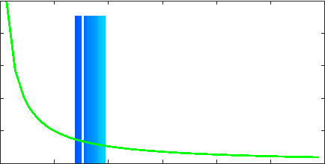










Measuring negative temperature
1
experiment
Well fitted by a Rayleigh-Jeans distribution
100
0
200
$$entropy$$
-1000
$${\left|c_{i}^{out}\right|}^{2}=\frac{T}{ε_{i}−μ}$$
Time steps m
0
$$m$$
500
300
$$1$$
400
$$T=−0.0077$$
$$μ=+1.75$$
$${\left|c_{i}\right|}^{2}$$
500
-10
0
10
$$0$$
x
$$0$$
$$π$$
$$ε_{i}$$
A. L. M. Muniz et al, “Observation of photon-photon thermodynamics in nonlinear multimode optical lattices.” (in preparation).

Slide 14
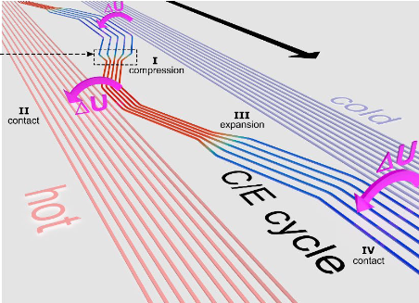


Optical thermodynamics contributes to
All-optical refrigeration via Carnot cycles.
New vistas in manipulating Bose-Einstein condensates.
Developing high-brightness optical sources.
F. Wu et al, Nature Photonics 13 (11), 776-782 (2019)

Slide 15
Additional information
Appendices

Slide 16
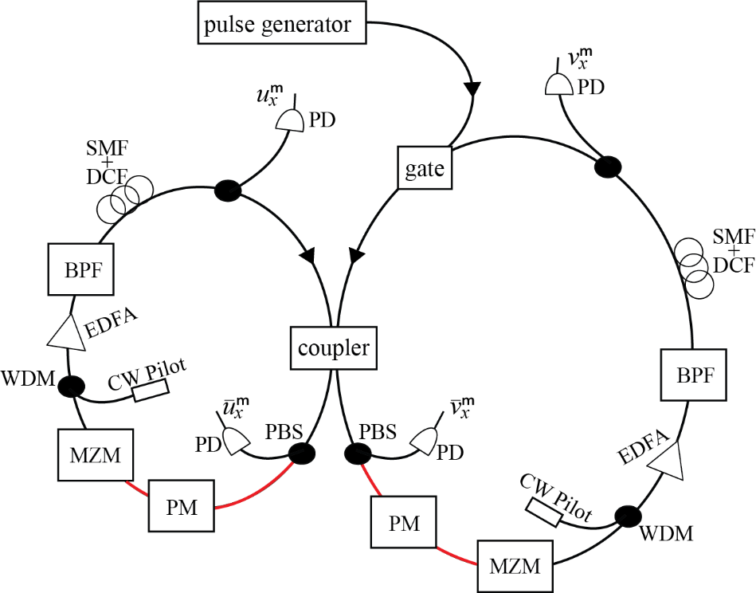
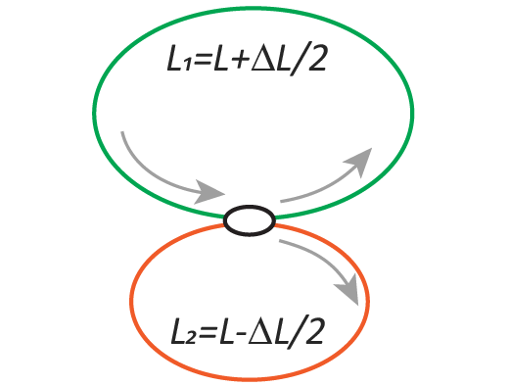
Experimental setup for classical pulses
Loop v
Loop v
Loop u
PM
50/50
Loop u

Slide 17
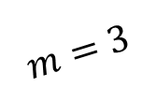
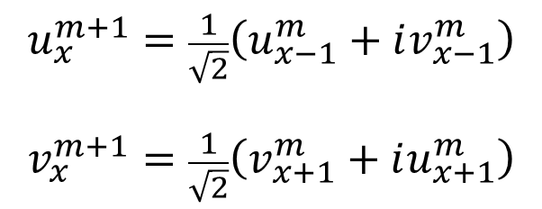
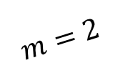
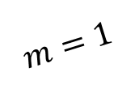
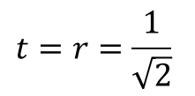

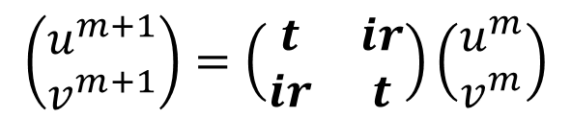

Evolution equations
Photo
detector
$$\left(\begin{matrix}u^{m+1} \\ v^{m+1}\end{matrix}\right)=\left(\begin{matrix}t & ir \\ ir & t\end{matrix}\right)\left(\begin{matrix}u^{m} \\ v^{m}\end{matrix}\right)$$
switcher
$$L_{1}$$
50/50 coupler
$$t=r=\frac{1}{\sqrt{2}}$$
Input
pulse
$$L_{2}$$
50/50
$$u_{x}^{m+1}=\frac{1}{\sqrt{2}}\left(u_{x−1}^{m}+iv_{x−1}^{m}\right)$$
$$v_{x}^{m+1}=\frac{1}{\sqrt{2}}\left(v_{x+1}^{m}+iu_{x+1}^{m}\right)$$
Loop v
$$m=1$$
Loop u
v
u
$$m=2$$
complex numbers
v
u
v
u
$$m=3$$
-2
-1
0
1
2
x

Slide 18
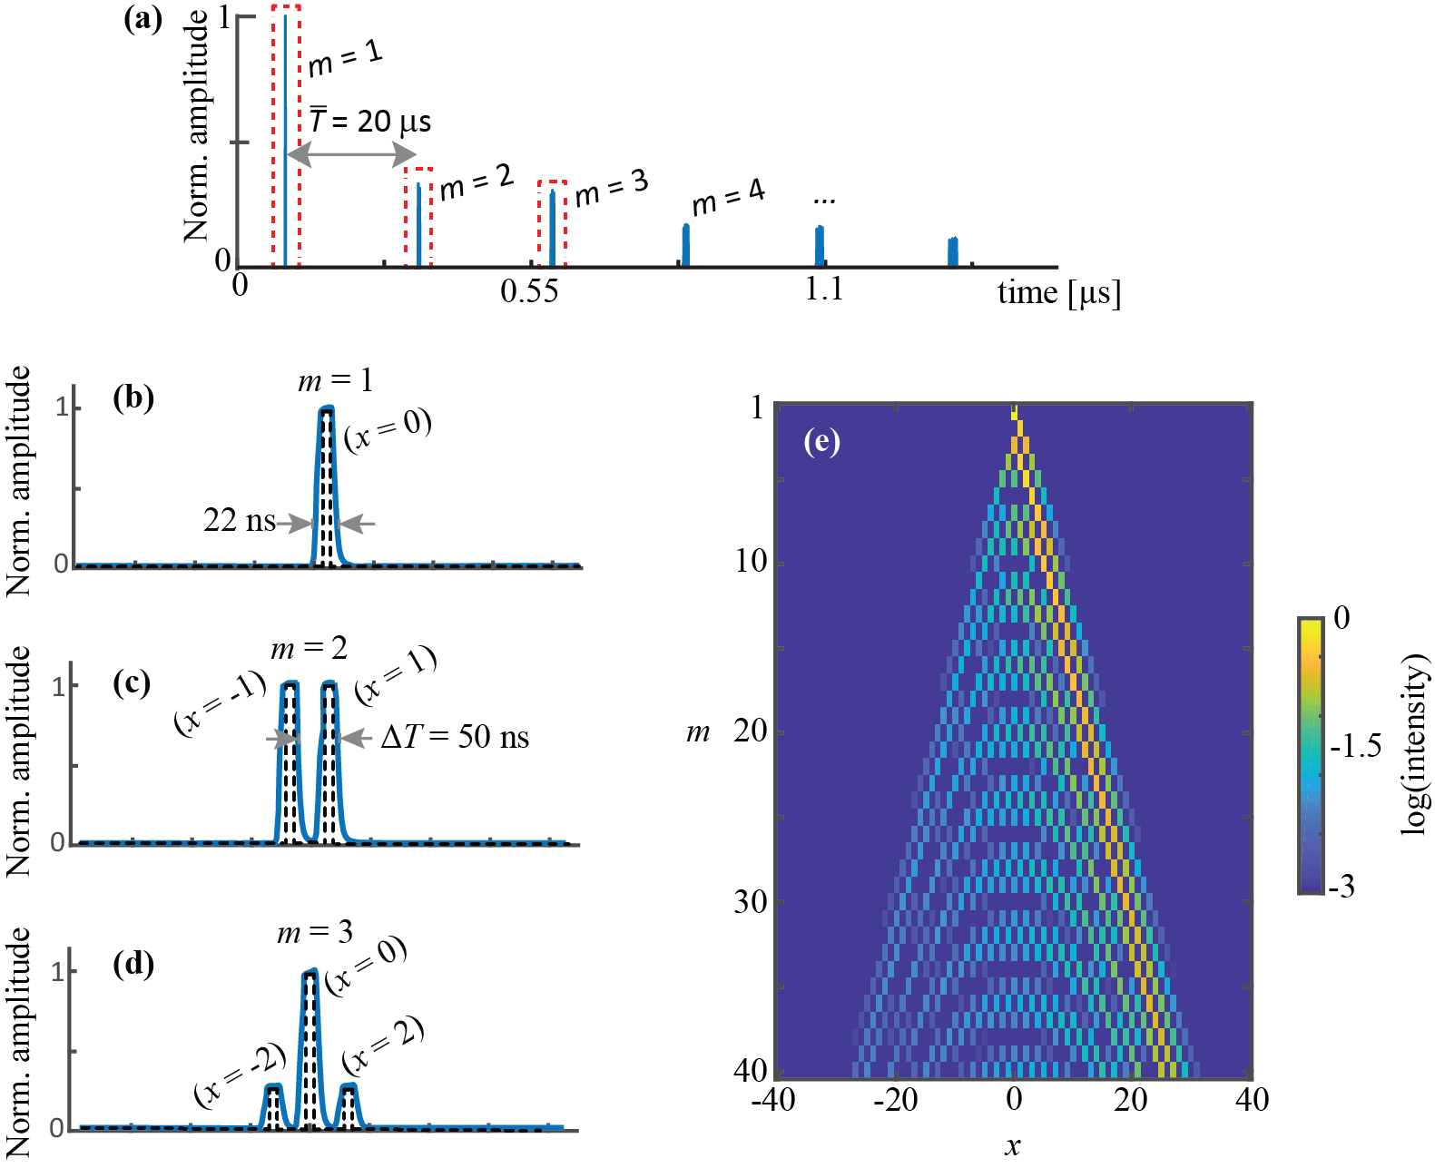


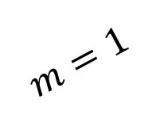

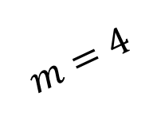

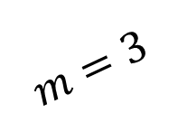
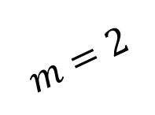

1D mesh lattice by using coupled-fiber loop
1
Time division multiplexing
1
$$∆T=50 ns$$
m
$$0$$
10
0
Norm. intensity
20
1
log(intensity)
$$−10$$
30
0
40
$$m=1$$
50
$$−20$$
1
-20
-10
0
10
20
$$\hat{T}=20 μs$$
x
Norm. intensity
$$m=2$$
$$m=3$$
$$m=4$$
0

Slide 19
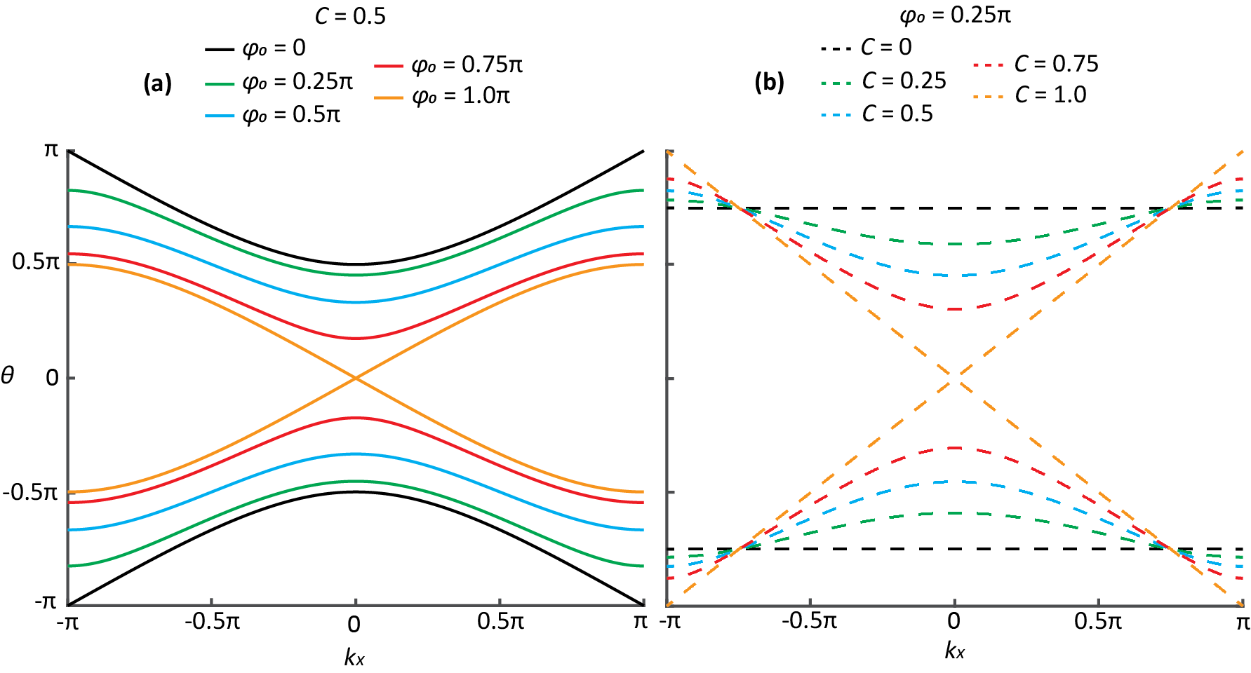




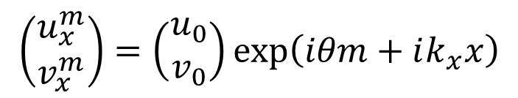
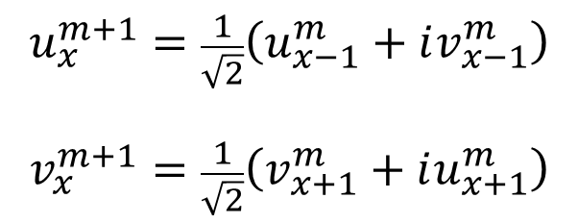

Pulse dynamics and phase modulation
Photo
detector
$$u_{x}^{m+1}=\frac{1}{\sqrt{2}}\left(u_{x−1}^{m}+iv_{x−1}^{m}\right)$$
$$v_{x}^{m+1}=\frac{1}{\sqrt{2}}\left(v_{x+1}^{m}+iu_{x+1}^{m}\right)$$
tunable phase
switcher
$$exp\left(iφ_{x}^{m}\right)$$
50/50
Loop v
$$φ$$
Loop u
Phase
modulator
$$θ$$
$$φ_{x}^{m}={\left(−1\right)}^{m}φ_{0}$$
$$\left(\begin{matrix}u_{x}^{m} \\ v_{x}^{m}\end{matrix}\right)=\left(\begin{matrix}u_{0} \\ v_{0}\end{matrix}\right)\exp\left(iθm+ik_{x}x\right)$$
Prop. const.
Momentum
$$k_{x}$$
Notes:
Additional phase applied by PM change the pulse dynamics

Slide 20
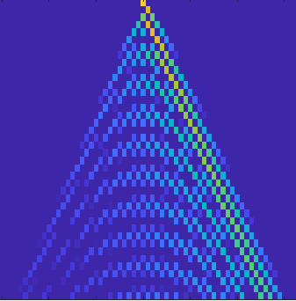
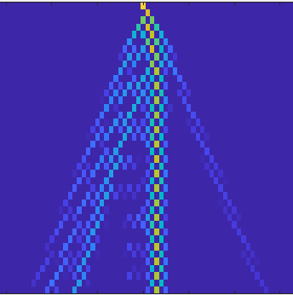
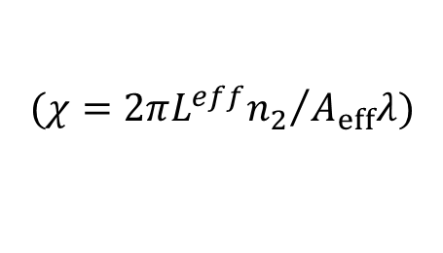
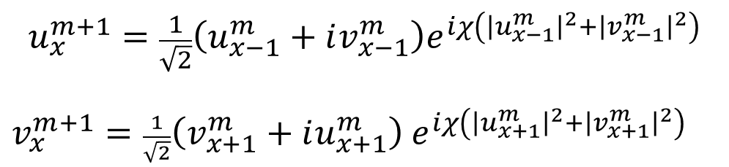


Nonlinear phase via HNLF
Photodetector
1
(1)
experiment
(2)
experiment
switcher
Highly nonlinear fiber
10
50/50
m
Loop v
20
Loop u
Optical pulses acquires a power-dependent nonlinear phase via self-phase modulation.
30
-20
0
20
-20
0
20
x
x
$$u_{x}^{m+1}=\frac{1}{\sqrt{2}}\left(u_{x−1}^{m}+iv_{x−1}^{m}\right)e^{iχ\left({\left|u_{x−1}^{m}\right|}^{2}+{\left|v_{x−1}^{m}\right|}^{2}\right)}$$
$v_{x}^{m+1}=\frac{1}{\sqrt{2}}\left(v_{x+1}^{m}+iu_{x+1}^{m}\right)$ $e^{iχ\left({\left|u_{x+1}^{m}\right|}^{2}+{\left|v_{x+1}^{m}\right|}^{2}\right)}$
$$P_{1, input}≪P_{2, input}$$
$${(χ=2π{L^{eff}n}_{2}}/{A_{eff}λ})$$
$χ→$ nonlinear coefficient

Slide 21
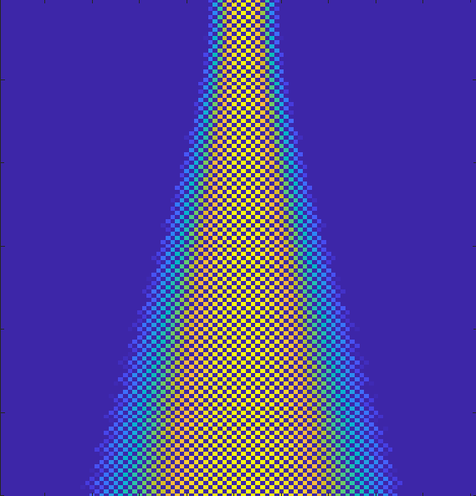
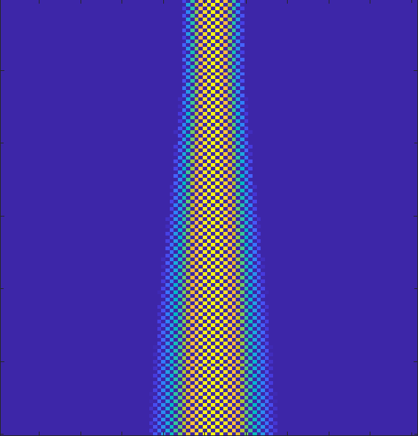




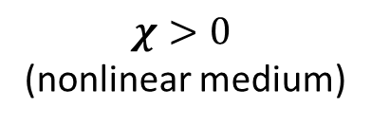

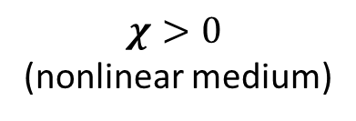



1D pulse dynamics and nonlinearity
$$P_{in, 1}≪P_{in, 2}<P_{in, 3}$$
(a)
$χ>0$
(nonlinear medium)
$χ>0$
(nonlinear medium)
(b)
$$χ=0$$
(c)
$$θ$$
(a)
$$P_{in, 1}$$
(b)
$$P_{in, 2}$$
(c)
$$P_{in, 3}$$
m
soliton
x
$$k_{x}$$
dispersion
Dispersion starting being compensated by nonlinear phase.
log(intensity)

Slide 22
Outline
Synthetic Dimensions
Optical Thermodynamics

Slide 23
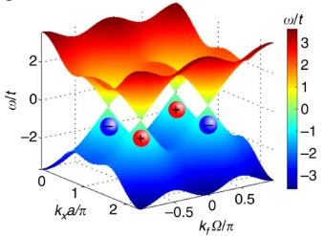
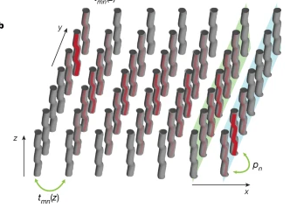
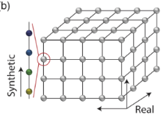
Synthetic dimensions enabling experiments
Aim: fully access the parameters to exploit complex physical phenomena.
Synthetic dimensions in photonics exploits the degrees of freedom of light;
  OAM, frequency, spatial modes, photon-phonon, and arrival time;
Enabling complex experiments in higher dimensional lattice, such as
  Quantum information processing, topological insulators, topological quantum states, photonic gauge potentials, PT-symmetry, micro-ring resonator modes, Bloch oscillations, nonlinear dynamics, optical thermodynamics, to mention a few.
Nature 567,
356–360 (2019)
Nat Rev Phys 1, 349–357 (2019)
Nat Commun 7, 13731 (2016)

Slide 24








1D mesh lattice via pulse arrival time
Here, we employ arrival time as a degree of freedom to create a 1D synthetic dimension.
$$(≈L_{1}−L_{2})$$
interference
$$Δw=22 ns$$
$$T=50 ns$$
Photo
detector
time
$$T=20 μs$$
$$(≈L_{1}+L_{2})$$
switch
1
$$L_{1}$$
0
Time steps
m
Input
pulse
$$L_{2}$$
50/50
2
-1
1
$$L_{1}>L_{2}$$
Loop v
3
time
Loop u
-2
0
2
Synthetic space x
Notes:
Pulses get delayed in the loop V and advanced in the loop U because of their fiber length.

Slide 25
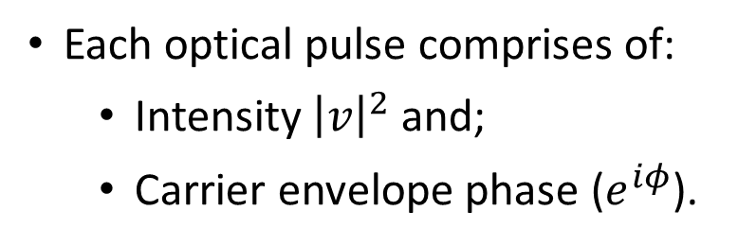

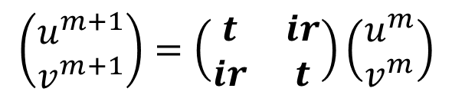









Mapping onto 1D synthetic space
$$L_{1}$$
By time division multiplexing technique, pulses are delayed ($x−1$) in loop v and advanced ($x+1$) in loop u.
Loop v
$$L_{2}$$
50/50
$$m=1$$
Loop u
v
u
Each optical pulse comprises of:
  Intensity ${\left|v\right|}^{2}$ and;
  Carrier envelope phase ($e^{iφ}$).
$${\left|v\right|}^{2}e^{iφ}$$
$$m=2$$
v
u
v
u
$$m=3$$
-2
-1
0
1
2
x
Optical pulses in loop v and u interfere at the 50/50 coupler;
Coupling matrix
$$\left(\begin{matrix}u^{m+1} \\ v^{m+1}\end{matrix}\right)=\left(\begin{matrix}t & ir \\ ir & t\end{matrix}\right)\left(\begin{matrix}u^{m} \\ v^{m}\end{matrix}\right)$$
$t=r=\frac{1}{\sqrt{2}}$ for 50/50 coupler
time step $m+1$
time step $m$

Slide 26










Mapping onto 1D synthetic space
$$m=2$$
1
1
The optical pulses mapped onto a (1+1)D synthetic space resemble the dynamics of a waveguide array.
10
$$0$$
0
Norm. intensity
$$m=3$$
1
20
log(intensity)
$$−1.5$$
m
0
30
t
$$−3$$
output
experiment
40
$$2$$
$$3$$
$$…$$
-20
-10
0
10
20
$$m=1$$
x
input

Slide 27








Band structure
As a periodic system, the mesh lattice possesses a band structure.
$$k_{x}$$
PD
$$θ$$
50/50
x
Loop v
$$φ$$
Loop u
Phase
modulator
m
$$θ$$
Phase modulation
$$\left(\begin{matrix}u_{x}^{m} \\ v_{x}^{m}\end{matrix}\right)=\left(\begin{matrix}u_{0} \\ v_{0}\end{matrix}\right)\exp\left(iθm+ik_{x}x\right)$$
$$φ_{x}^{m}={\left(−1\right)}^{m}φ_{0}$$
Prop. const.
Momentum
A.L.M. Muniz, Opt. Lett. 44 (24), 6013-6016, 2019
$$k_{x}$$

Slide 28


Nonlinear phase by self-phase modulation
PD
1
experiment
experiment
(1)
(2)
Highly nonlinear fiber
10
50/50
m
Loop v
20
Loop u
Optical pulses acquire a power-dependent nonlinear phase via self-phase modulation.
30
-20
0
20
-20
0
20
x
x
${\left|v\right|}^{2}e^{iφ}$ $e^{iχ{\left|v\right|}^{2}}$
$$P_{1, input}≪P_{2, input}$$
$χ→$ nonlinear coefficient

Slide 29
Outline
Synthetic Dimensions
Optical Thermodynamics

Slide 30

Exploiting synthetic space for experiments
Optical thermodynamics
It is a recent theory to understand and predict the complex nonlinear response of a multimode system.
Beam self-cleaning:
Increasing the initial power
Flow of power to lower-order modes
Why?
Experimentally challenging for hundreds or thousands of modes.
Wu, F.O. et al. Nat. Photonics 13, 776–782 (2019).
M. Parto et al. Opt. Lett., 2019.
L. G. Wright et al. Nat. Photonics, 2016.
There is no experimental realization until now.
Notes:
Lately, a rather peculiar effect has been consistently reported in several experimental studies, whereby the power in a multimode nonlinear fiber was found to eventually settle into the lower group of modes: the so-called beam self-cleaning effect. This intriguing mechanism has nothing to do with any Raman and/or self-focusing effects, but instead is a byproduct of multi-wave mixing energy exchange.
In this formalism, the complex interactions in these heavily multimoded systems are treated via statistical mechanics, and the beam self-cleaning effect is explained as a thermalization process aiming to extremize the underlying optical entropy.

Slide 31



Comparing to classical thermodynamic theory
Standard thermodynamics at the micro-canonical level
Formulation of optical thermodynamics
at the micro-canonical level
Multimode fiber
Photonic entropy S
= S(U, M, P)
Entropy S = S(U, V, N)
U: Energy
V: Volume
N: particle number
$U$: photonic internal energy (Hamiltonian)
$M$: number of modes
$𝒫$: optical power (photon number)
eigenmodes
to predict temperature, pressure and chemical potential
Maximize
entropy S
to predict the final power distribution among modes
Maximize
photonic entropy S
Notes:
At this point, the question naturally arises as to whether these thermodynamic parameters are unique, and if so, what are the general conditions determining their accessible range.
Statistical mechanics is one of the fundamental tools of modern physics. It is a mathematical framework that applies statistical methods and probability theory to large assemblies of microscopic entities. It does not assume or postulate any natural laws, but explains the macroscopic behavior of nature from the behavior of such ensembles.
The primary goal of statistical thermodynamics (also known as equilibrium statistical mechanics) is to derive the classical thermodynamics of materials in terms of the properties of their constituent particles and the interactions between them. In other words, statistical thermodynamics provides a connection between the macroscopic properties of materials in thermodynamic equilibrium, and the microscopic behaviours and motions occurring inside the material.
Whereas statistical mechanics proper involves dynamics, here the attention is focussed on statistical equilibrium (steady state).
Statistical equilibrium does not mean that the particles have stopped moving (mechanical equilibrium), rather, only that the ensemble is not evolving.

Slide 32




Mesh lattice as a multimode system
the inner 50/50 coupler is replaced by a variable coupler (VC).
Thus, creating a finite section with a limited number of well-defined modes.
VC
m
Loop v
Loop u
Switching the VC to full reflection at the domain boundaries in order to reflect pulses into the mesh lattice.
Reflective boundaries
VC
Full reflection
$$m$$
$$x$$
Notes:
To experimentally observe the aforementioned optical thermodynamic effects, we employ a conservative nonlinear time-synthetic optical mesh lattice^{36,37} that supports a finite number of modes $M$ (in the time domain), whose power occupancies can be monitored in real time via mode demultiplexing techniques

Slide 33














Eigenmodes and modal occupancy
Propagation matrix
$$\left[\left.Ψ_{k},exp{(}{iθ}_{k}\right)\right]=eig\left(\hat{ℳ}\left(φ_{0},C\right)\right)$$
$${\left|c_{k}\right|}^{2}={\left|Ψ_{k}^{′}∗ψ\right|}^{2}$$
Coupling ratio
Distribution in loop v and u
Matrix of eigenmodes
Phase mod.
System’s eigenmodes
$$Ψ_{k=N}$$
Modal occupancy ${\left|c_{k}\right|}^{2}$
$$Ψ_{k=4}$$
${\text{4}}^{o}$
Each eigenmode has an amplitude and phase distribution
$$Ψ_{k=3}$$
${\text{3}}^{o}$
Coupling via weakly nonlinearity
$$Ψ_{k=2}$$
${\text{2}}^{o}$
power
$$Ψ_{k=1}$$
$1^{o}$
$$Ψ_{k=0}$$
Fund.
Eigenvalue$θ_{k}$
Synthetic space x
Notes:
Each mode i is associated with a particular propagation constant and an orthonormal eigenfunction |ψi 〉 as obtained from the pertinent eigenvalue problem. The distribution of the normalized propagation eigenvalues εi constitutes the eigenspectrum of the system. In all occasions, the optical power P propagating in this system is conserved. As we will see, the role of nonlinearity is to allow for a random power exchange among the various modes.

Slide 34










Extensive variables and modal occupancy
$$U=\sum_{k}{θ_{k}{\left|c_{k}\right|}^{2}}$$
Modal occupancy
$U$: internal energy
$M$: number of modes
$𝒫$: optical power
$${\left|c_{k}\right|}^{2}$$
$$m=1$$
(playing the role of a thermodynamic volume )
An example of initial mode distribution
$$𝒫=\sum_{k}{{\left|c_{k}\right|}^{2}}$$
Eigenvalue $θ$
output
$$2$$
$$3$$
$$…$$
Extensive variables are initially defined
$$m=1$$
input
Notes:
Here, $U$ represents the Hamiltonian “inner energy”, $M$ is the total number of modes playing the role of a thermodynamic volume and $𝒫$ is the total power flowing in the multimode arrangement corresponding to the particle number in statistical mechanics. Both $U$ and $𝒫$ are specified by the initial excitation conditions.
As shown in Refs. [14,16], in nonlinear multimode structures $T,μ$ represent thermodynamic forces that govern the flow of $U,𝒫$between two optical subsystems, respectively. Depending on initial conditions $\left(U,𝒫\right)$, the system can settle in either positive or negative temperatures – both being direct manifestations of entropy maximization.
Depending on initial conditions $\left(U,𝒫\right)$, the system can settle in either positive or negative temperatures – both being direct manifestations of entropy maximization

Slide 35












Thermalization process via entropy growth
The multimode system undergoes thermalization to maximize its entropy according to the second law of thermodynamics.
subcase of the Bose–Einstein distribution: the so-called Rayleigh–Jeans distribution.
once thermalization is attained, the output possesses
It is a statistical model (i.e., ensemble averages).
$$\frac{1}{T}=\left(\frac{∂S}{∂U}\right)$$
global equation of state
$$U−μ𝒫=MT$$
$$S=\sum_{k=1}^{N}{{ln\left|c_{k}\right|}^{2} }$$
Maximum entropy value
$$\frac{μ}{T}=\left(\frac{∂S}{∂𝒫}\right)$$
$T$: optical temperature
$μ$: chemical potential
Modal
Occupancy ${\left|c_{k}\right|}^{2}$
Rayleigh-Jeans distribution
output
$$3$$
$$…$$
$${\left|c_{k}\right|}^{2}=\frac{T}{μ+θ_{k}}$$
$$2$$
$$m=1$$
input
Eigenvalue $θ$
Wu, F.O. et al. Nat. Photonics 13, 776–782 (2019).
Notes:
Within this isolated microcanonical ensemble, we may then pose the following question: If the total optical power is subdivided into a very large number of indistinguishable packets (each carrying the same infinitesimal amount of power), in how many ways can one distribute them into M distinct modes—subject to the constraint imposed by U and P being constant? Given that, under these conditions, the number of such packets per state is exceedingly high, maximization of entropy directly leads to a subcase of the Bose–Einstein distribution—the so-called Rayleigh–Jeans (RJ) distribution
In general, the system is expected to reach thermal equilibrium by maximizing its entropy. It is a statistical models, which is practically impossible for one tracking these processes in a deterministic fashion, on a mode-by-mode basis. It is for this very reason that statistical models have been pursued in the past, in an effort to describe the macroscopic properties of this class of nonlinear “many-body” systems.
Entropy may also be viewed as a physical measure concerning the microscopic details of the motion and configuration of a system, when only the macroscopic states are known. Such details are often referred to as disorder on a microscopic or molecular scale, and less often as dispersal of energy. For two given macroscopically specified states of a system, there is a mathematically defined quantity called the 'difference of information entropy between them'. This defines how much additional microscopic physical information is needed to specify one of the macroscopically specified states, given the macroscopic specification of the other – often a conveniently chosen reference state which may be presupposed to exist rather than explicitly stated.
A final condition of a natural process always contains microscopically specifiable effects which are not fully and exactly predictable from the macroscopic specification of the initial condition of the process. This is why entropy increases in natural processes – the increase tells how much extra microscopic information is needed to distinguish the initial macroscopically specified state from the final macroscopically specified state. Equivalently, in a thermodynamic process, energy spreads.
Exemple of 3rd thermodin.
Theory: A system's entropy approaches a constant value as its temperature approaches absolute zero.
At absolute zero there is only 1 microstate possible (Ω=1 as all the atoms are identical for a pure substance and as a result all orders are identical as there is only one combination) and ln(1) = 0.

Slide 36













Multimodal states in thermal equilibrium
Experimental results of thermalization process
1
experiment
$$𝒫=1$$
$$U=1.87$$
$$M=22$$
$50$ ensembles
Theory
Input
Output ($m=500$)
100
$${\left|c_{k}\right|}^{2}$$
1
0.2
Experiment
0.5
200
$${\left|c_{k}^{out} \right| }^{2}$$
$$θ$$
0
$$φ_{0}=π/4$$
m
-0.5
300
0.1
$${\left|c_{k}^{in}\right|}^{2}$$
-1
-1
-0.5
0
0.5
1
$$k_{x}/π$$
400
System thermalized
500
0
$${\left|c_{k}^{out}\right|}^{2}=\frac{T}{θ_{k}−μ}$$
$$T=+0.0088$$
$$μ=+2.55$$
-10
0
10
0.5
0.7
0.9
x
Eigenvalues $θ/π$
Well fitted by a Rayleigh-Jeans distribution
Notes:
Note that in the first case the final temperature is positive, indicating that the eigenmodes closer to the ground state (at the top of the positive branch) are thermodynamically favored.system while any exchange of optical power is driven by the difference in chemical potentials

Slide 37












Maximizing photonic entropy
Lower group of modes is mostly occupied as in the case of beam self-cleaning;
State of maximum entropy = mode distribution thermalized
1
0.5
$$θ/π$$
0
$$φ_{0}=π/4$$
$$S\left(m\right)=\sum_{k=1}^{N}{{ln\left|c_{k}^{m}\right|}^{2} }$$
Entropy
-0.5
-1
-1
-0.5
0
0.5
1
Entropy
$${\left|c_{i}^{out}\right|}^{2}$$
$$k_{x}/π$$
$${\left|c_{i}^{in}\right|}^{2}$$
-80
$$S\left(m\right)$$
0.1
$$T=+0.0088$$
$$μ=+2.55$$
0.1
-100
0
0.5
0.6
0.7
0
$$θ/π$$
0.5
0.6
0.7
$$θ/π$$
-120
$$m$$
A. L. M. Muniz et al, “Observation of photon-photon thermodynamics in nonlinear multimode optical lattices.” (in preparation).
Notes:
During the process of thermalization, the total entropy always increases in such a way that the ‘internal energy’ flows from a hotter to a colder substates.
Thermal equilibrium (leading to an RJ distribution) can only be reached in non-extended nonlinear optical arrangements (having a finite number of modes), as long as the underlying nonlinear mechanisms promote dynamical chaos so as to establish ergodicity. In this respect, chaos is expected to take place in the system whenever the additional invariants needed for integrability (besides the Hamiltonian and the norm) are absent.

Slide 38












Negative temperature in thermal equilibrium
Experimental results of thermalization process
experiment
Theory
$$𝒫=1$$
$$U=2.34$$
$$M=22$$
$50$ ensembles
Input
Output ($m=500$)
100
$${\left|c_{k}\right|}^{2}$$
0.2
1
Experiment
200
0.5
m
$$θ$$
0
$$φ_{0}=π/4$$
$${\left|c_{k}^{out} \right| }^{2}$$
300
0.1
-0.5
$${\left|c_{k}^{in}\right|}^{2}$$
-1
-1
-0.5
0
0.5
1
400
$$k_{x}/π$$
System thermalized
500
0
$${\left|c_{k}^{out}\right|}^{2}=\frac{T}{θ_{k}−μ}$$
$$T=−0.0077$$
$$μ=+1.75$$
-10
0
10
0.5
0.7
0.9
x
Eigenvalues $θ/π$
Well fitted by a Rayleigh-Jeans distribution
Notes:
Now, only this time the power tends to flow towards the highest group of modes, in direct contrast to beam self-cleaning. Negative temperatures are common to systems with a finite number of modes, when the internal energy exceeds the mean value of the eigenvalue spectrum.
On the other hand, in the second case, the temperature after thermalization is negative and thus higher-order modes are preferably populated.

Slide 39







Negative temperature and entropy
1
For negative temperatures, after the thermalization is attained, the higher-order modes are populated.
0.5
$$θ$$
0
$$φ_{0}=π/4$$
$$S\left(m\right)=\sum_{k=1}^{N}{{ln\left|c_{k}^{m}\right|}^{2} }$$
-0.5
Entropy
-1
-1
-0.5
0
0.5
1
Entropy
$$k_{x}/π$$
-80
$${\left|c_{i}^{out}\right|}^{2}$$
$${\left|c_{i}^{in}\right|}^{2}$$
$$S\left(m\right)$$
0.1
$$T=−0.0077$$
$$μ=+1.75$$
0.1
-100
0
0.5
0.6
0.7
0
$$θ/π$$
0.5
0.6
0.7
$$θ/π$$
-120
1
100
200
300
400
500
$$m$$
A. L. M. Muniz et al, “Observation of photon-photon thermodynamics in nonlinear multimode optical lattices.” (in preparation).

Slide 40




Isentropic (adiabatic) processes
1
experiment
Adiabatic means that entropy does not change ($dS=0$)
Input: optical mode in thermal equilibrium;
During the isentropic process:
  Number of modes remains the same;
  Lattice coupling adiabatically increases / decreases during the propagation;
$${\left|c_{i}^{in}\right|}^{2}$$
100
0.1
200
0
$$θ/π$$
m
300
out (in)
(Increasing coupling)
expansion
400
500
compression
-10
0
10
in (out)
(decreasing coupling)
x
Notes:
Because of adiabaticity, the modal occupancies ${\left|c_{k}\right|}^{2}$ remain invariant and so does the optical entropy $S=\sum_{k}{\ln{{\left|c_{k}\right|}^{2}}}$

Slide 41

















Isentropic (adiabatic) compression/expansion
Entropy is kept maximized.
Internal energy $U$ is subject to a negative (positive) change during expansion (compression);
$${\frac{T_{in}}{μ_{in}}}/{\frac{T_{out}}{μ_{out}}}=1$$
$$U/T=μ/T=constant$$
$${\left|c_{k}\right|}^{2}=\frac{T}{θ_{k}−μ}$$
Theory
experiments
Input
Output
1.2
Expansion
Compression
$$C=0.5$$
0.2
$$T_{in}=−0.0094$$
$$μ_{in}=1.21$$
$$T_{out}=−0.0189$$
$$μ_{out}=1.68$$
$$T_{in}=−0.0099$$
$$μ_{in}=1.21$$
$$T_{out}=−0.0079$$
$$μ_{out}=0.69$$
U
$$C=0.3$$
0.16
Increasing $C$
0.8
0.12
$${\left|c_{k}\right|}^{2}$$
0.08
Decreasing $C$
0.04
0.4
$$C=0.1$$
0
1
250
500
-1
-0.4
0
0.4
1
-1
-0.4
0
0.4
1
m
$$θ/π$$
$$θ/π$$
$$C=0.3→0.5$$
$$C=0.3→0.1$$
A. L. M. Muniz et al, “Observation of photon-photon thermodynamics in nonlinear multimode optical lattices.” (in preparation).
Notes:
Adiabatic >> no heat flow; kept entropy maximized
No heating exchange

Slide 42





Joule expansion
1
Input: optical mode in thermal equilibrium;
During the Joule expansion:
  Sudden increase in the number of modes ($M_{1}→M_{2}$) realized by an expansion of the mesh lattice positions.
$${\left|c_{i}^{in}\right|}^{2}$$
100
0.1
200
0
$$θ/π$$
$$m$$
300
Output
400
500
experiments
Input
-20
0
20
$$x$$
Notes:
Unlike isentropic processes, Joule photon-gas expansion is thermodynamically irreversible² and transpires while the internal energy $U$ of the system remains constant .

Slide 43










Joule expansion
During this process:
  Density of states $M$ is doubled (lattice size increased by 2);
  At the output:
    $M_{2}=2M_{1}$.
    $T_{out}=T_{in}\frac{M_{2}}{M_{1}},$ while $μ_{1}=μ_{2}$.
1
100
Theory
$$T={\left(\frac{∂S}{∂U}\right)}^{−1}=\frac{U^{2}−4C_{e}^{2}𝒫^{2}}{2UM}$$
Input
Output
200
0.16
$$m$$
$$μ=−T\left(\frac{∂S}{∂𝒫}\right)=\frac{U^{2}−4C_{e}^{2}𝒫^{2}}{2U𝒫}$$
0.12
300
$${\left|c_{k}\right|}^{2}$$
0.08
$$T_{out}≈2T_{in}$$
$$T_{in}=0.0115$$
$$T_{out}=0.006$$
$$μ_{1}=μ_{2}=1.2$$
400
0.04
experiments
0
500
-1
-0.4
0
0.4
1
-20
0
20
$$θ/π$$
$$x$$
A. L. M. Muniz et al, “Observation of photon-photon thermodynamics in nonlinear multimode optical lattices.” (in preparation).
Notes:
The photonic response observed here is in stark contrast to the Joule expansion behavior expected from say ideal monoatomic gases, where the temperature or kinetic energy of the particles remains constant while the chemical potential substantially changes. Similar results are obtained in the negative optical temperature domain

Slide 44
Optical thermalization processes
Additional content

Slide 45








2. Optical thermodynamic theory
Nonlinear medium
$$P=\sum{{\left|c_{k}\right|}^{2}}$$
$$U=−\sum{θ_{k}{\left|c_{k}\right|}^{2}}$$
$${\left|c_{k}\right|}^{2}=−\frac{T}{θ_{k}+μ}$$
Optical modes (M)
randomly distributed
$$U−μ.P=M.T$$
$${\left|c_{k}\right|}^{2}$$
$${\left|c_{k}\right|}^{2}$$
$T$ : temperature
$μ$ : chemical potential
Rayleigh-Jeans distribution
U: photonic internal energy (Hamiltonian);
M: number of modes;
P: optical power (photon number);
$$θ$$
$$θ$$
M. Parto et al. Opt. Lett. 44 (16), 2019.

Slide 46
















2. Preparation of optical modes
Generation of a broad Gaussian beam;
Creating a double band structure by phase modulatiom;
Truncating the lattice to 21 sites by switching the coupling;
Appling amplitude and phase modulation to excite the modes;
1
m
60
21
Mode number
$$π$$
$$φ=0.25π$$
0.5$π$
$$θ$$
0
-0.5$π$
Each eigenmode has an amplitude and phase distribution
$$−π$$
$$−π$$
-0.5$π$
0
0.5$π$
$$π$$
$$θ$$
up to 21 “box” modes
$$−π$$
-0.5$π$
0
0.5$π$
$$π$$
$$k_{x}$$

Slide 47




Optical thermodin.: preparation of modes
Eigenmodes calculation (depend on phase modulation and coupling)
1
m
$$\left[\left.Ψ_{k},exp{(}{iθ}_{k}\right)\right]=eig\left(\hat{ℳ}\left(φ_{0},C\right)\right)$$
60
21
Matrix of eigenmodes ($2N+2$ elements)
Creating a random superposition of modes of one band by amplitude and phase modulation.
Summing up
$$ψ^{m=1}=\sum_{k=1}^{2N+2}{s_{k}Ψ_{k}}=\left(\begin{matrix}V′ \\ U′\end{matrix}\right)$$
Superposition: Amplitude and phase distribution
phase amplitude
π
Eigenmodes
0
“switching”-mode vector + random phase
-π
$$\left(\begin{matrix}\begin{matrix}1e^{2πR} & 0e^{2πR}\end{matrix} & \begin{matrix}1e^{2πR} & 0e^{2πR}\end{matrix}\end{matrix}\right)$$
R: random number [0,1]

Slide 48


Propagation of modes
1
m
60
Propagation up to 500 time steps ($m$);
Decomposition into linear modes.
Optical modes interact by weakly nonlinearity;
100
$${\left|c_{k}^{m}\right|}^{2}={\left|Ψ_{k}^{′}∗ψ^{m}\right|}^{2}$$
250
Distribution in loop v and u
System’s eigenmodes
Modal occupancy
$$ψ^{m}={\left[\begin{matrix}v_{x=−\frac{N}{2}}^{m} & \begin{matrix}⋯ & v_{x=0}^{m} & ⋯\end{matrix} & v_{x=\frac{N}{2}}^{m} & u_{x=−\frac{N}{2}}^{m} & \begin{matrix}⋯ & u_{x=0}^{m} & ⋯\end{matrix} & u_{x=\frac{N}{2}}^{m}\end{matrix}\right]}^{−1}$$
500
-10
0
10
x

Slide 49

Isentropic processes / Joule expansion

Slide 50





Acknowledgement
My parents in Brazil and my beloved wife Glenda F. Zanela for all the help.
Prof. Ulf Peschel for Ph.D. supervision;
Technical discussions with Dr. Arstan Bisianov and Dr. Martin Wimmer;
Project collaboration with Prof. Roberto Morandotti (INRS-Montreal, CA), Dr. Pawel Jung and Prof. Demetri Christodoulides (UCF-Florida, US), Dr. Alessandro Alberucci (FSU-Jena, DE).
GRK 2101 research groups (in special to the PhD coordinator Dr. Anna Späthe);
FSU collegues;
Collaborations with

Slide 51


Thank you for your attention!

